Slide 1

Local Disaster Warning & Response Coordination Platform
Team-Kala Dhua
Ayush Pathak
Tushar Singh
Shreeviraj Matale

Slide 2








ABSTRACT
The problem
Our answer
Warnings arrive, but responders don't know which settlements are hit first, which roads are still open, or which ground reports are real — so help is coordinated over phone calls.
Indradhanu turns live rain, river and terrain data plus citizen, crew, CCTV and offline-mesh reports into explained ward-level alerts, and sends the right unit on a road that is still open.
Any hazard
Any district
6 channels
Seconds
Flood first; heat, fire, air and seismic adapters built in
Live in Pune (16 wards) and Ghaziabad (14 wards)
App, crew, agency API, sensors/VLM, mesh, simulator
to re-plan after any report, road block or unit change
Built for: Local Disaster Warning & Response Coordination — connect flood warnings with affected settlements and road accessibility, explain every alert, and prioritise response.

Slide 3






IDEA TITLE
Indradhanu: Offline Disaster Management and Agentic Resource Orchestration
Report
Verify
Prioritise
Route
Re-plan
citizen, crew, camera, mesh
trust score + clustering
ward risk × severity
CP-SAT on open roads
on every change
WARN
VERIFY
ACT
Ward flood risk with evidence and confidence
Trust-scored reports; fakes quarantined
Nearest right unit, open road, officer sign-off
One shared picture for the control room, citizens and field crews — command wall, live map, approvals, safe routes.

Slide 4
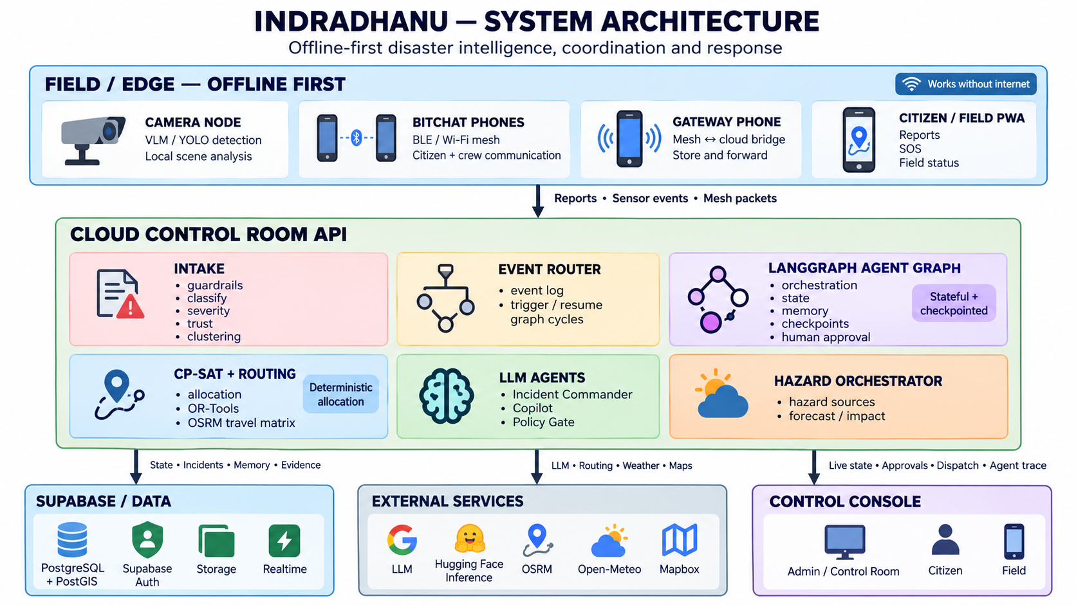
TECHNICAL APPROACH
Tech stack
Backend
FastAPI
asyncpg
Render
AI & agents
LangGraph
CP-SAT
XLM-R
Gemini
Data & maps
PostGIS
Supabase
Mapbox
OSRM
Hazard data
Open-Meteo
GloFAS
Edge & UI
BLE mesh
YOLO+VLM
React
Decision loop — runs again the moment anything changes
Ingest
Verify
Score
Gate
Solve
Send
Replan

Slide 5

FEASIBILITY AND VIABILITY
Every expected outcome, covered
Measured on the live system
Multiple district, Multiple hazard
Pune, flood — plus a live Ghaziabad region
362 reports
■ 86 auto-confirmed
■ 266 corroborating
■ 10 quarantined (2.8%)
Rainfall & terrain data
Open-Meteo rain, GloFAS river, elevation, history
Settlements & road closures
Population at risk per ward; blocked roads removed
Priorities update live
Event-driven re-plan; officer approves severity ≥ 4
Evidence & confidence
Drivers, contribution %, lead time, confidence
384/384
20
False alerts & route validity
Trust quarantine + scripted disruption tests
routes on real roads
road blocks avoided
Replay clearly labelled
Runs stored as live | replay with original date
Viable: runs on free tiers today; production moves the LLM on-prem (vLLM). Works offline over the mesh.
Live database figures, 29 Sep 2026

Slide 6




IMPACT AND BENEFITS
Faster response
No double-dispatch
Routes that work
Units tasked seconds after a report is corroborated, not after phone calls.
One incident per street, one plan for the city — no two boats on one lane.
Nobody is sent down a road already reported blocked.
Works offline
Explainable alerts
Fully auditable
Bluetooth mesh carries SOS and camera reports until one phone finds signal.
Every alert shows why: rain, river, terrain, history — and a confidence.
Append-only event log; every decision can be replayed afterwards.
Who benefits: control rooms and ward officers · NDRF, SDRF, fire and 108 EMS crews · residents of low-lying settlements · relief camps and hospitals.

Slide 7

RESEARCH AND REFERENCES
Disaster management & data
Methods & tools
1. NDMA — Guidelines: Management of Urban Flooding (2010)
1. Google OR-Tools — CP-SAT solver
sdma.goa.gov.in (NDMA text)
developers.google.com/optimization
2. UNDRR — Sendai Framework for DRR 2015–2030
2. LangGraph — stateful agent graphs
undrr.org
langchain-ai.github.io/langgraph
3. Copernicus GloFAS — Global Flood Awareness System
3. Conneau et al. (2020) — XLM-R
global-flood.emergency.copernicus.eu
arxiv.org/abs/1911.02116
4. Open-Meteo — Flood (river discharge) API
4. Mapbox Matrix API — travel times
open-meteo.com/en/docs/flood-api
docs.mapbox.com/api/navigation/matrix
5. IMD — India Meteorological Department
5. OSRM — Open Source Routing Machine
mausam.imd.gov.in
project-osrm.org
6. 2019 Pune flood (case study)
6. PostGIS — spatial database
en.wikipedia.org/wiki/2019_Pune_flood
postgis.net
7. Hindon flood, Ghaziabad — Sphere India SitRep (Jul 2023)
7. bitchat — Bluetooth mesh messaging
sphereindia.org.in
github.com/permissionlesstech/bitchat

Slide 8




DEMO AND LINKS
Demo video
https://drive.google.com/drive/folders/1E0f-8UN0E90Q-JqiThZmdZ4bCUTLC7C_?usp=sharing
Live console
Citizen app (no login)
distro-ruddy.vercel.app
distro-ruddy.vercel.app/citizen
Backend API
GitHub repository
disruptionops.onrender.com/api/v1
github.com/officialayush23/DisruptionOps
Try it: open the citizen app, file a flood report, and watch it reach the command wall, get a trust score and a unit dispatched on an open road.

